Slide 1
The Communication Process

Slide 2



Goals
What is Formal and informal Communications
Describe 4 Communication Channels
Using Brainstorming Sessions as a form of communication

Slide 3

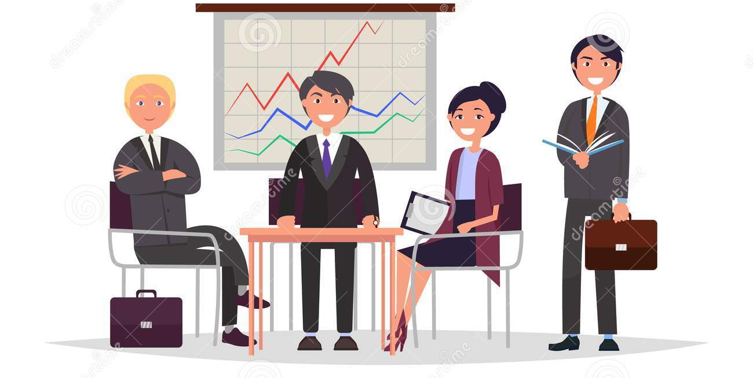
Formal Vs Informal communication
Formal Communication
Informal Communication
the exchange of official information – work related matters
Well thought out and planned – takes time to convey
flows along the different levels of the organizational hierarchy (up, down, across)
Follows rules, policy, standards, processes and regulations of the organization
Casual and often unofficial communication
Unplanned messages – personal matters or business reminders
Fast and time savings
information is exchanged spontaneously between two or more persons
Does not conform to the official rules or processes

Slide 4
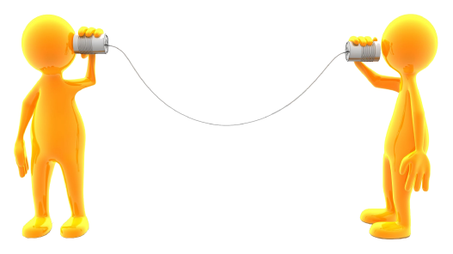
Managers Spend 2/3 of their day Communicating
Communication is vital in running an organization and provides a link between employees and customers and between employees and manager.
Managers Communicate in 4 ways:
Speaking
Listening
Writing
Reading

Slide 5
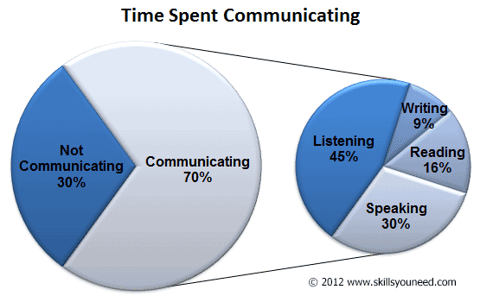
How Managers Communicate

Slide 6


What is meant by media
Forms or channels of how we communicate
Media - communication outlets or tools used to store and deliver information
Also known as medium or mediums (multiple)
AKA: Channel Management

Slide 7

Think about it: You are working in a restaurant. You have a new low-fat menu item that is not selling well. What channel management decisions (media) would you make to increase sales on this product?

Slide 8
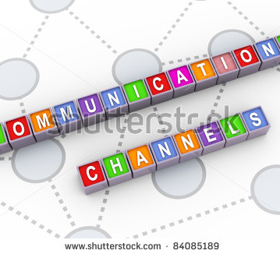
Four Channels of Communication
Channels of communication – the means by which the message is conveyed
Oral Communication
Written Communication
Nonverbal Communication
Electronic Communication

Slide 9

Oral Communication
Phone calls
Meetings – group or individual
Presentations
Group Brainstorming activities
Brainstorming: group discussion technique used to generate as many ideas as possible
Focus Groups: group interview involving a small number of similar people
Providing instruction on tasks/duties
Formal – prepared and structured meetings
Informal discussions – happens by chance

Slide 10
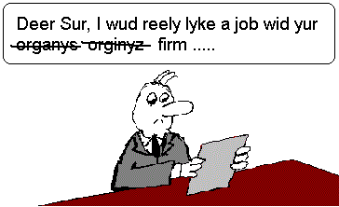
Written Communication
Letters
Emails
Reports
Proposals (written report)
Memos
Invoices
Pictographs (image messages)
Faxes
Bulletin Boards
Messages
Newsletters
Employee Manuals – Policy Manuals, employee handbooks etc.
News Release
Flyers/Announcements

Slide 11
How to Write an Effective Communication
Subject clearly catches their attention – What your message is about
Opening - Since this is a friendly reminder, it's a good idea to start the message on a positive note. This keeps your message from seeming too harsh. If you can't think of anything specific, state something friendly like "I hope you are doing well."
Body of the Message - This is where you need to communicate the purpose of the message. Think carefully about what you want to say here. Be as clear as possible. Explain exactly what is overdue or what needs to be addressed (work, behavior, timeliness, etc.). Explain the impact, the effect, or the results of not doing or doing the behavior
Closing: Call to Action - Finally, tell the message recipient what you'd like them to do. Usually, this is a request for them to perform a desired action—It's also a good idea to offer help, such as an offer to answer questions.

Slide 12
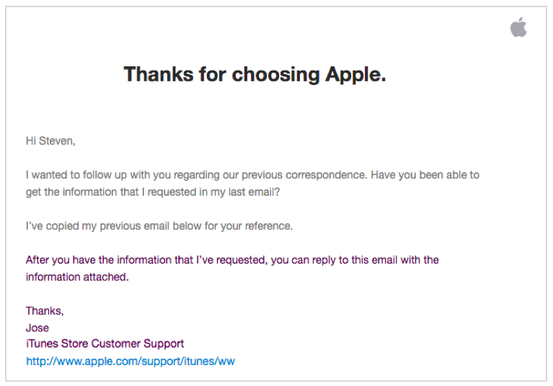
When to use emails
Emails - most common form of communication in business
Used both within an organization and outside
For fast, temporary communications that readers quickly read, act on, and delete
Speedy updates, short reminders or check-ins, time-sensitive announcements, and similar short-lived messages
Use a Catchy Subject line
As always, needs an Introduction, a Body, and a Closing
Always have a greeting (salutation) and closing
Salutation (greeting) less formal: Hello Nate or Nate
Do not use slang such as Yo Nate
Closing can be sincerely or just Thank you and followed by your name, organization, and title
If possible, limit email length to what appears on screen
Use one blank line between paragraphs to avoid “Wall of Text” Syndrome

Slide 13
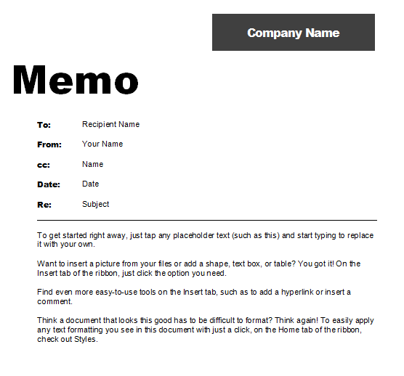
When to use memos
Communication within an organization
For proposal, a serious recommendation, a technical explanation, a new policy, or something that readers will consult more than once
Will be printed and posted on a bulletin board
If contains bullet points, bold headings, columns, tables, or graphs
Use a Cathy/specific Subject line
As always, needs an Introduction, a Body, and a Closing paragraph
Try to keep is short with ½ page
To send your memo, simply attach it to a brief email.

Slide 14
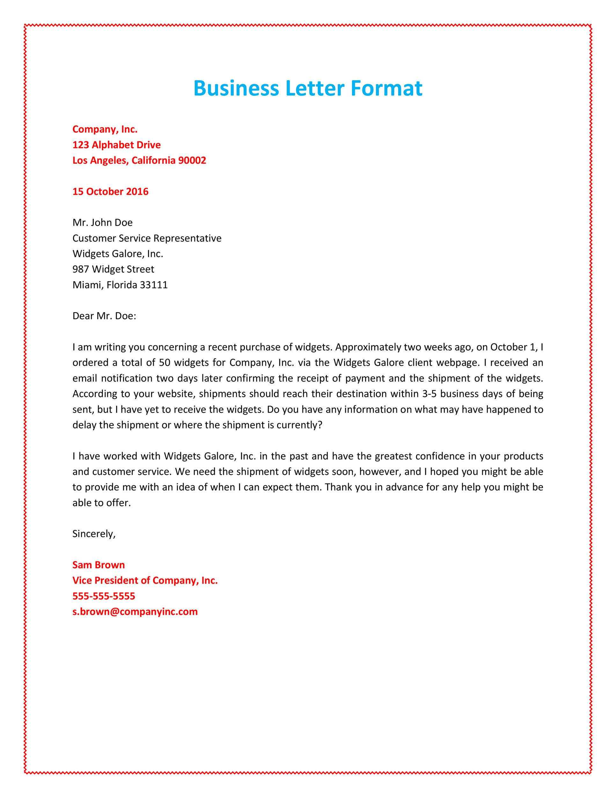
When to use letters
Letters are typically sent to recipients outside an organization
May be used within an organization if the topic is very formal and/or non-routine
Ex: written warning in an employee’s file
Often sent to a company, its clients, employees, or stakeholders
Serious and formal types of correspondence
Reference letters
Employment verification
Job Offers
Contracts
Includes a greeting Salutation
Dear Mr. Smith
As always needs an Introduction, a Body, and a Closing to the body of the letter
Formal Closing: Sincerely
Name and contact information

